Slide 1
A Progress Report on BGP
Geoff Huston
APNIC

Slide 2
Agenda
In this presentation we will explore the space of inter-domain routing (the Border Gateway Protocol – BGP
  We will look at the growth of the eBGP routing table over time and some projections for future growth
  Then we’ll look at the dynamic behaviour of eBGP, and the extent to which more specifics are dominating routing table growth ... or not

Slide 3
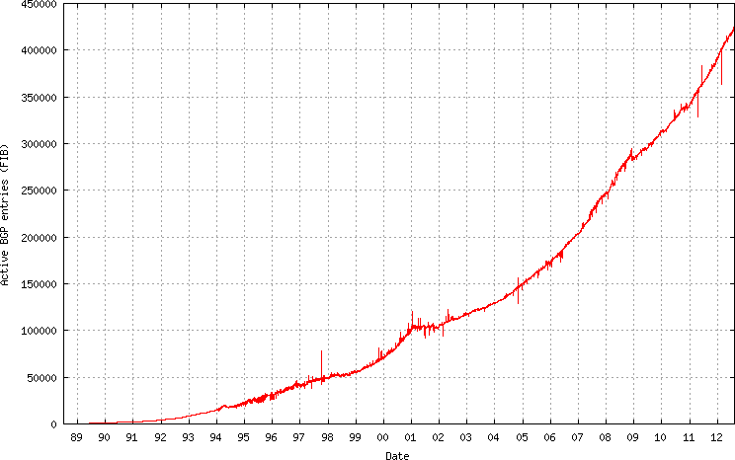
The Big Picture of the v4 Routing Table

Slide 4
The Big Picture of the v4 Routing Table
Address Exhaustion
The GFC hits the Internet
Broadband to the Masses
The Great Internet Boom
and Bust of 2000/2001
Introduction of
CIDR – March 1994

Slide 5
IPv4 BGP Prefix Count 2011 - 2012

Slide 6
IPv4 BGP Prefix Count 2011 - 2012
APNIC IPv4 runout

Slide 7
IPv4 BGP Prefix Count 2011 - 2012
Is this growth now linear?
(5K prefixes per month)

Slide 8
IPv4 Routed Address Span

Slide 9
IPv4 Routed Address Span
/8 advertisements (by RIRs)
APNIC IPv4 runout

Slide 10
IPv4 Routed AS Count

Slide 11
IPv4 2012 BGP Vital Statistics
1-Jan-12 31-Jul-12
Prefix Count 390,000 422,000 +14% p.a.
Roots 190,000 205,000 +13%
More Specifics 200,000 217,000 +15%
Address Span 149 /8s 153 /8s + 5%
AS Count 39,800 41,800 + 9%
Transit 5,700 6,000 + 9%
Stub 34,100 35,800 + 9%

Slide 12
IPv4 in 2011
Table growth remains surprisingly consistent
Overall Internet growth in terms of BGP is at a rate of some ~14% p.a.
  This is much the same as 2009 - 2011.
Address span is now growing more slowly than the table size

Slide 13
IPv6 BGP Prefix Count

Slide 14
IPv6 BGP Prefix Count
2012
IPv6 Launch Day
2011
World IPv6 Day

Slide 15
IPv6 Routed Address Span

Slide 16
IPv6 Routed AS Count
2012
IPv6 Launch Day
2011
World IPv6 Day

Slide 17
IPv6 2011 BGP Vital Statistics
Jan-12 Jul-12 p.a. rate
Prefix Count 7,759 9,950 + 48%
Roots 5,751 6,420 + 20%
More Specifics 2,008 3,530 +130%
Address Span (/32s) 53,387 49,803 - 12%
AS Count 4,968 5,915 + 33%
Transit 985 985 + 0%
Stub 3,983 4,730 + 32%

Slide 18
IPv6 in 2010 - 2011
Overall IPv6 Internet growth in terms of BGP is 50 % p.a.
(Looking at the AS count, if these relative growth rates persist then the IPv6 network would span the same network domain as IPv4 in 6 years time -- mid/late 2018)

Slide 19
Projections

Slide 20
BGP Size Projections
Generate a projection of the IPv4 routing table using a quadratic (O(2) polynomial) over the historic data
  For IPv4 this is a time of extreme uncertainty
    Registry IPv4 address run out
    Uncertainty over the impacts of any after-market in IPv4 on the routing table
  which makes this projection even more
  speculative than normal!

Slide 21
IPv4 Table Size
400,000
300,000
200,000
100,000
2004
2006
2008
2010
2012

Slide 22
Daily Growth Rates
200
100
GFC
0
-50
2004
2006
2008
2010
2012

Slide 23
Table Growth Model
810 year² – 3,219,734 year + 3,199,162,643
400,000
300,000
200,000
100,000
2004
2006
2008
2010
2012

Slide 24
IPv4 Table Projection
500,000
300,000
100,000
2004
2008
2012
2016

Slide 25
IPv4 BGP Table Size predictions
Jan 2011 347,000 entries
2012 390,000 entries
2013 431,000 entries
2014* 473,000 entries
2015* 517,000 entries
2016* 563,000 entries
* These numbers are dubious due to uncertainties introduced by IPv4 address exhaustion pressures.

Slide 26
IPv6 Table Size
10,000
8,000
6,000
4,000
2,000
2007
2008
2009
2010
2011
2012
2013

Slide 27
Daily Growth Rates
World IPv6 Launch
16
World IPv6 Day
6,000
12
4,000
8
4
0
0
2007
2008
2009
2010
2011
2007
2008
2009
2010
2011
2012
2013

Slide 28
IPv6 Table Projection
433 year² – 1,740,154 year + 1,747,148,098
30,000
e ** (0.478 * year - 953)
20,000
10,000
2007
2009
2011
2013
2015

Slide 29
IPv6 BGP Table Size predictions
Jan 2011 4,000 entries
2012 8,000 entries
2013 11,600 entries
2014 16,300 entries
2015 21,900 entries
2016 28,300 entries

Slide 30
Up and to the Right
Most Internet curves are “up and to the right”
But what makes this curve painful?
  The pain threshold is approximated by Moore’s Law

Slide 31
Moore’s Law
As a rough rule of thumb, if the rate of growth of the table grows at a rate equal to, or less than Moore’s Law, then the unit cost of storing the forwarding table should remain constant
  Like all rough rules of thumb, there are many potential exceptions, and costs have many inputs as well as the raw cost of the the number of gates in a chip
  Despite this, Moore’s Law still a useful benchmark of a threshold of concern about routing growth

Slide 32
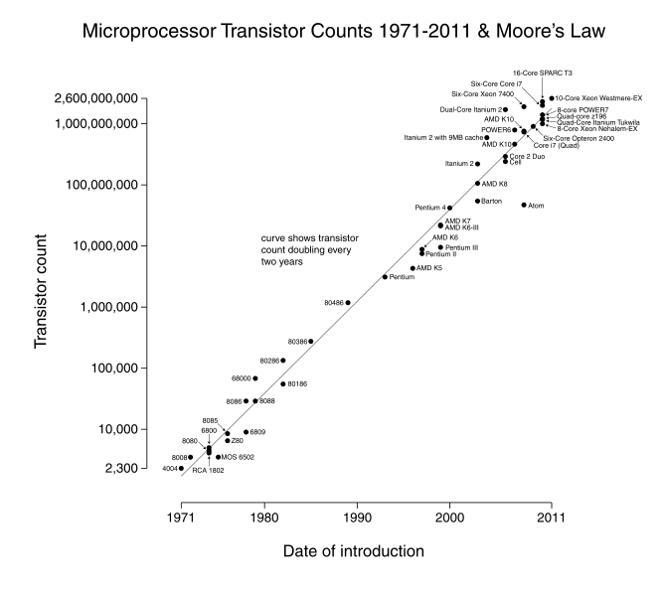

Slide 33
IPv4 BGP Table size and Moore’s Law
Moore’s Law
BGP Table Size Prediction

Slide 34
IPv6 Projections and Moore’s Law
Moore’s Law
BGP Table Size Predictions

Slide 35
eBGP Table Growth
Nothing in these figures suggests that there is cause for urgent alarm -- at present
The overall eBGP growth rates for IPv4 are holding at a modest level, and the IPv6 table, although it is growing rapidly, is still relatively small in size in absolute terms
As long as we are prepared to live within the technical constraints of the current routing paradigm it will continue to be viable for some time yet

Slide 36
NATTing the Net
In the previous 12 months:
  The RIRs allocated 109M IPv4 addresses
  The routing table grew by 120M addresses
  The ISC host survey* indicates a growth of ~90M visible hosts
  BUT
    Apple sold ~100M iphones and they have 24% market share
    This implies that some ~400M mobile devices were deployed in the last 12 months
    And that does not include Androids, Kindles, iPads, etc
  It appears that the NATTed Internet grew by ~600M devices in the last 12 months!
* http://www.isc.org/solutions/survey

Slide 37
Aggregation
To what extent do we still practice “conservative” routing and refrain from announcing more specifics into the routing table?
Are we getting better or worse at aggregation in routing?
What is the distribution of advertising more specifics? Are we seeing a significant increase in the number of more specific /24s in the routing table?

Slide 38
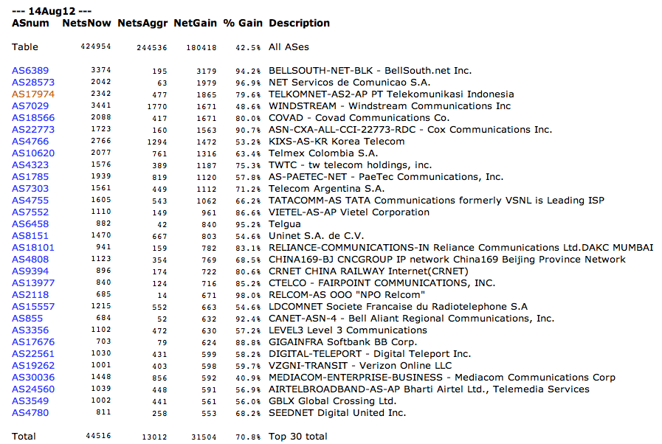
Who is doing this the most?
www.cidr-report.org

Slide 39
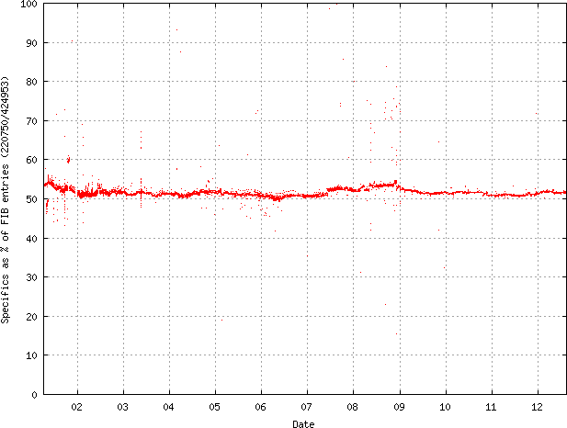
More specifics in the Routing Table
Since 2001 more specifics account for ~50% of the Routing Table.

Slide 40
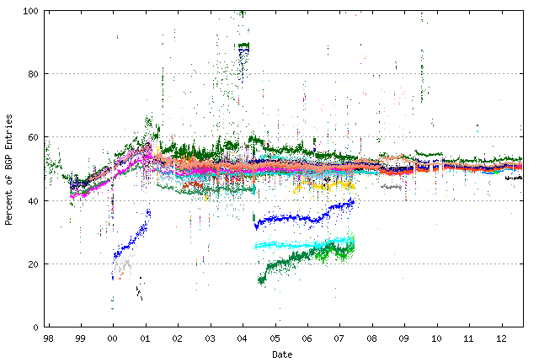
Does everyone see this?
% of entries that are more specific -- as seen by peers of Route Views

Slide 41
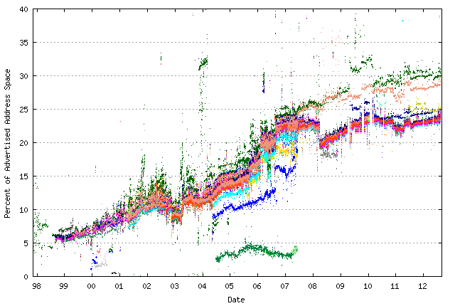
How much address space is announced by more specifics?
% of address space announced by more specifics – as seen by peers of Route Views

Slide 42
Are We Getting Any Better?
Take the daily top 10 ASes over the past 3 years and track the number of more specifics advertised by these ASes over the entire period

Slide 43
Yes ... and No

Slide 44
Is Routing still Scaling?
Yes – this has been relatively flat or the past 5 years!

Slide 45
Instability Events per day
And so has this!

Slide 46
Convergence is improving!
Or, at the very least, its not getting any worse!

Slide 47
Convergence is improving!
Why is this trend down and not up?

Slide 48

What is going on?
The “shape” of the Internet determines the scalability of the Internet’s routing system
If the Internet “expands” then the AS paths lengthen. This means that a distance vector algorithm will take longer to converge, and send more updates in the process

Slide 49
What is going on?
The “shape” of the Internet determines the scalability of the Internet’s routing system
If the Internet “expands” then the AS paths lengthen. This means that a distance vector algorithm will take longer to converge, and send more updates in the process – this is NOT the case for the Internet

Slide 50

What is going on?
The “shape” of the Internet determines the scalability of the Internet’s routing system
If the Internet “compresses” then the AS paths length remain steady. This means that a distance vector algorithm will behave consistently over time. This compression is achieved by “clustering” of new entrants around existing AS’s, increasing the connectivity density of the larger AS’s

Slide 51
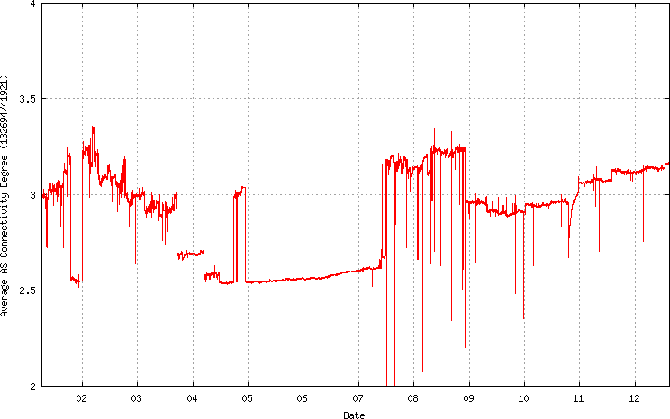
The Shape of the Internet
The Internet’s carriage transit environment is becoming less diverse as the transit tiers are being compressed – AS connectivity is becoming denser
Average
AS
Connectivity

Slide 52
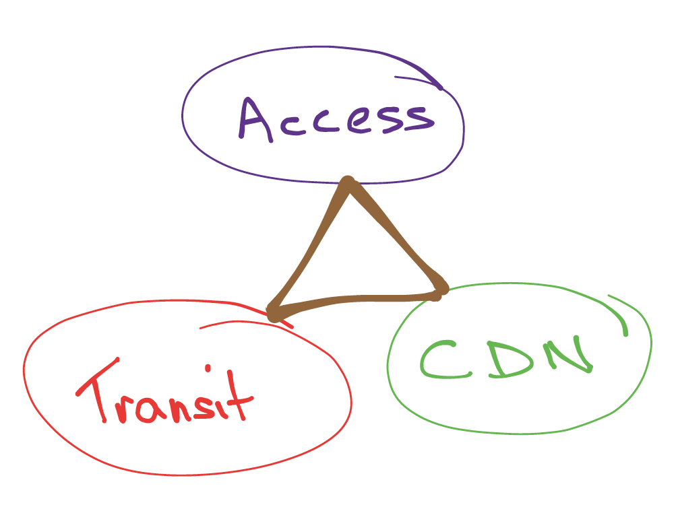
The Shape of the Internet
AS’s are no longer all the same - they are now specialized into distinct roles

Slide 53
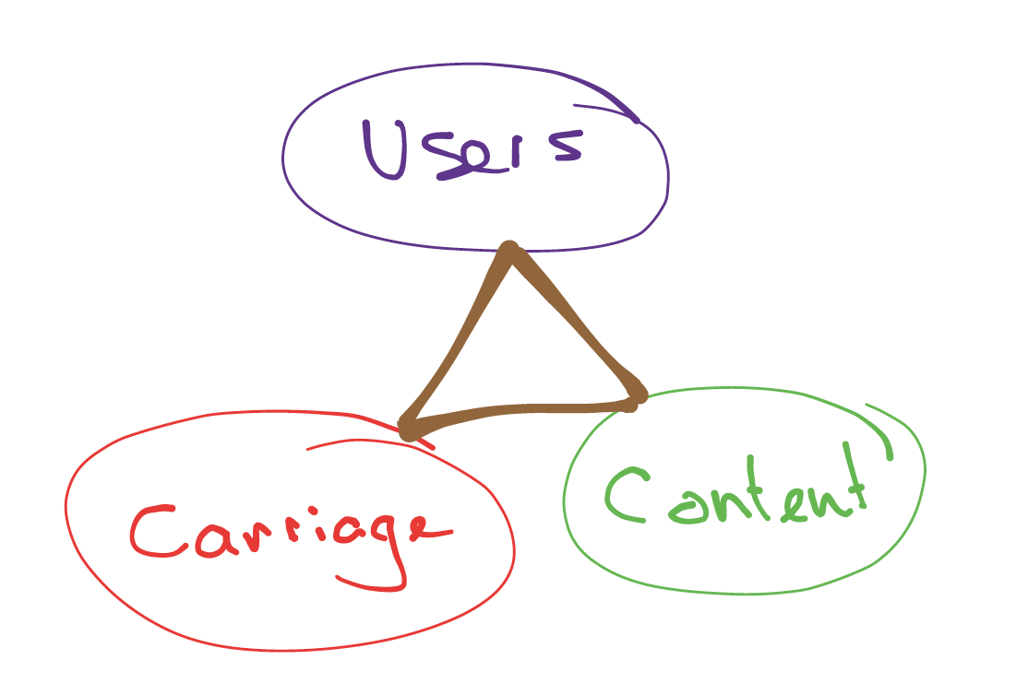
The Shape of the Internet
This AS specialization mirrors the underlying segmentation of the market into distinct activity sectors, each of which is trying to maximize efficiency through economies of scale

Slide 54


Thank You
Questions?
labs

