Slide 1
RPKI Trust Anchor
Geoff Huston
APNIC

Slide 2
Public Keys
How can you “trust” a digital signature?
What if you have never met the signer and have no knowledge of them or their keys?
One approach is transitive trust via a hierarchy of public key certificates
  (there are other approaches, based on “web of trust” models, but lets not go there)
?
Signed by foo!

Slide 3

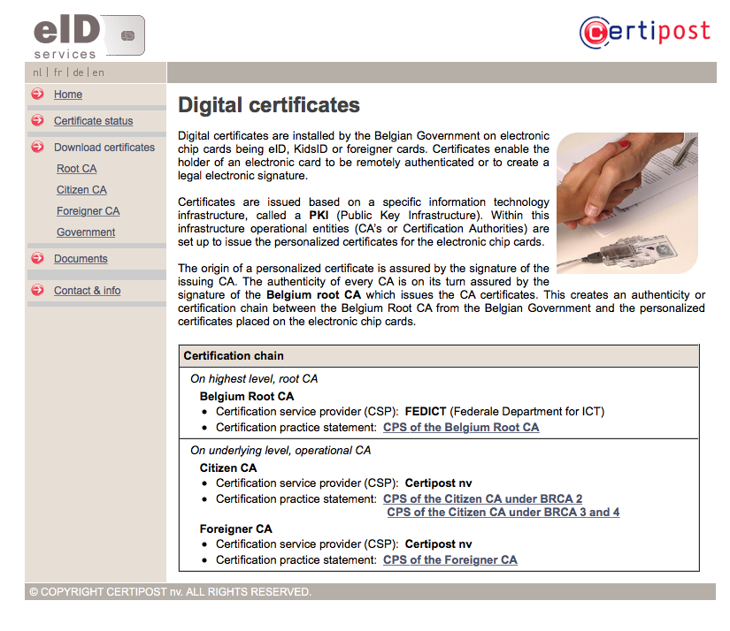
Public Key Infrastructure
For transitive trust, you have to start somewhere with some initial entity (or entities) in whom you are prepared to trust
This is your TRUST ANCHOR set, and you keep a local copy of their public key in your certificate store as Trusted Certificates
Each Trust Anchor entry matches a unique PUBLIC KEY can can be used to certify a Certificate issued by this Certification Authority
Key Store
?
Signed by foo!

Slide 4
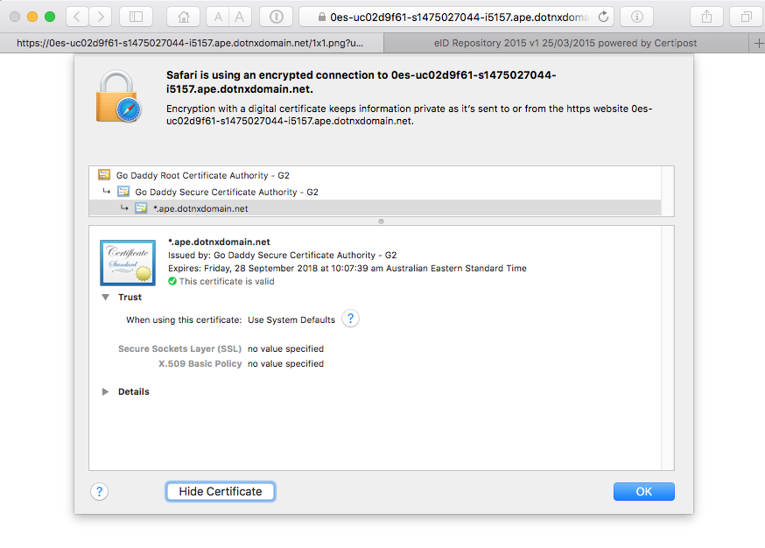
Public Key Infrastructure
Validation is a process of finding a chain of public key certificates that link a trust anchor to the entity being validated in this manner
Key Store
?
Signed by foo!

Slide 5
The Resource Public Key Infrastructure
The RPKI is a conventional PKI where the Certificate Issuer certifies BOTH the public key of the subject and the subject’s number resource holdings
As it is a conventional PKI, the RPKI needs to have Trust Anchor(s)
What models can be used to publish proposed Trust Anchors for the RPKI?
And who can (or should) publish this Trust Anchor Material?

Slide 6
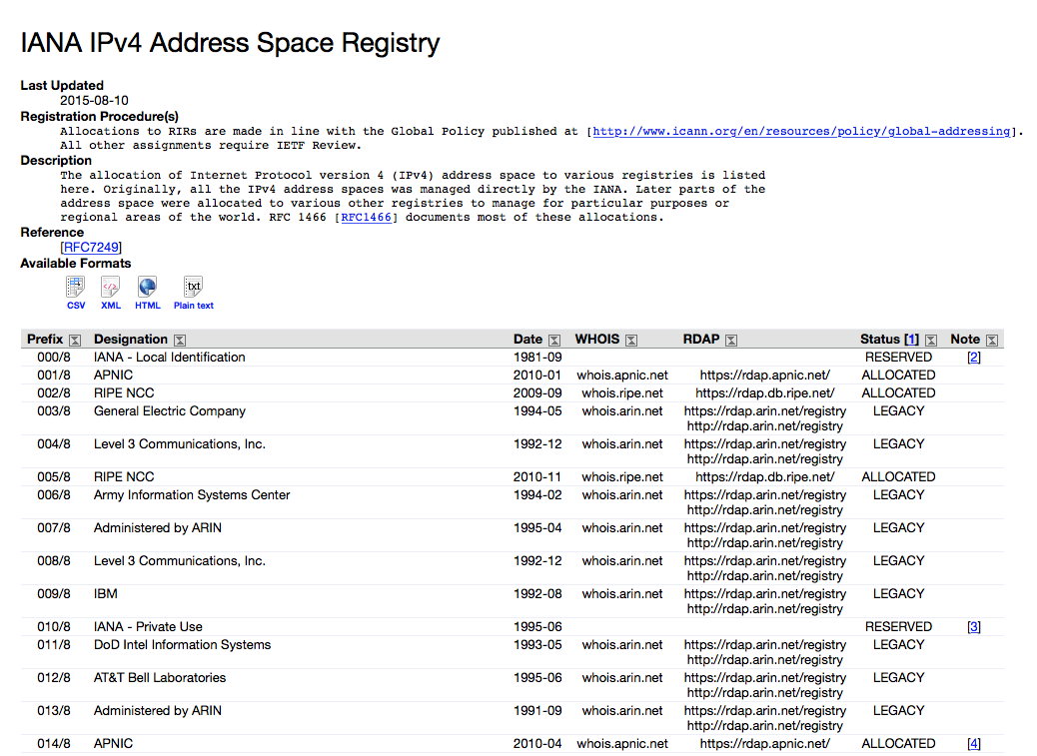
RPKI Certificates Follow Allocations:
A single IANA-issued Trust Anchor
IANA
0/0
Public Key
AFRINIC
APNIC
ARIN
LACNIC
RIPE NCC
Number Resource contents of RIR Subordinate CAs issued by the IANA match the contents of the IANA Number Registries

Slide 7
RPKI Certificates Follow Allocations:
A single IANA-issued Trust Anchor
IANA
0/0
Public Key
AFRINIC
APNIC
ARIN
LACNIC
RIPE NCC
The issue here is how to certify transferred resources. These resources are not separately listed in the IANA registries so will not be included in the IANA-issued CA Certificate.
If we want to preserve this clear top-level certificate model then the implication is that modelling transferrred resources in this RPKI will:
require RIRs to issue certificates for each other
and because the certification validation paths will differ, a user holding transferred resources may be issued with multiple certificates

Slide 8
IANA TA, RPKI Certificates Follow Allocations
IANA
0/0
Public Key
AFRINIC
APNIC
ARIN
LACNIC
RIPE NCC
From
APNIC
From
ARIN
From
LACNIC
From
AFRINIC
From
ARIN
From
LACNIC
From
AFRINIC
From
APNIC
From
LACNIC
From
AFRINIC
From
APNIC
From
ARIN
From
AFRINIC
From
APNIC
From
ARIN
From
RIPE NCC
From
RIPE NCC
From
RIPE NCC
From
RIPE NCC
From
LACNIC
This results in a complex inter-RIR CA structure to support transfers
And ALL RIRs need to be in a position to support this model as a precondition to adoption
But if one of more RIRs are not ready to do this, what can be done?

Slide 9
Interim APNIC TA Structure
APNIC
From
AFRINIC
From
ARIN
From
LACNIC
From
RIPE NCC
The interim model used by APNIC promotes the 5 “top level” certificates where APNIC would be the subject into a compound trust anchor containing 5 self-signed certificates
This will allow APNIC to migrate to a single IANA TA without major change (the self signed certificates are changed to certificate signing requests and the local trust structure can be removed)

Slide 10
Other possible interim TA models
APNIC
All resources in
APNIC’s registry
This is a much simpler model, and is the one used by other RIRs as an interim per-RIR TA
But this is some distance from the requirements to support a single IANA TA in the future
So the amount of work and user impact to transform from this self-signed TA cert structure to a single IANA TA would be far larger

Slide 11
Other possible interim TA models
APNIC
0/0
All resources
This simplifies the TA structure further, as no changes are required to the TA in the event of resource movement. The published per RIR TA is essentially static so off-line (or even one-shot use) keys can be used
However it does not reflect APNIC’s current resource holdings in the TA certificate

Slide 12
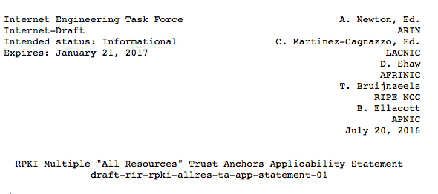

Slide 13
Comments?
Questions?

Slide 14
