Slide 1







IPv4

Slide 2

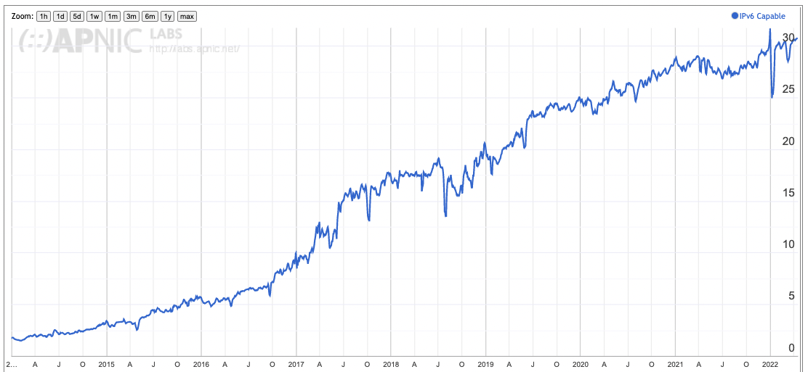
Where are we with IPv6 adoption?
At the start of 2022 IPv6 finally touched 30% of the world’s users

Slide 3
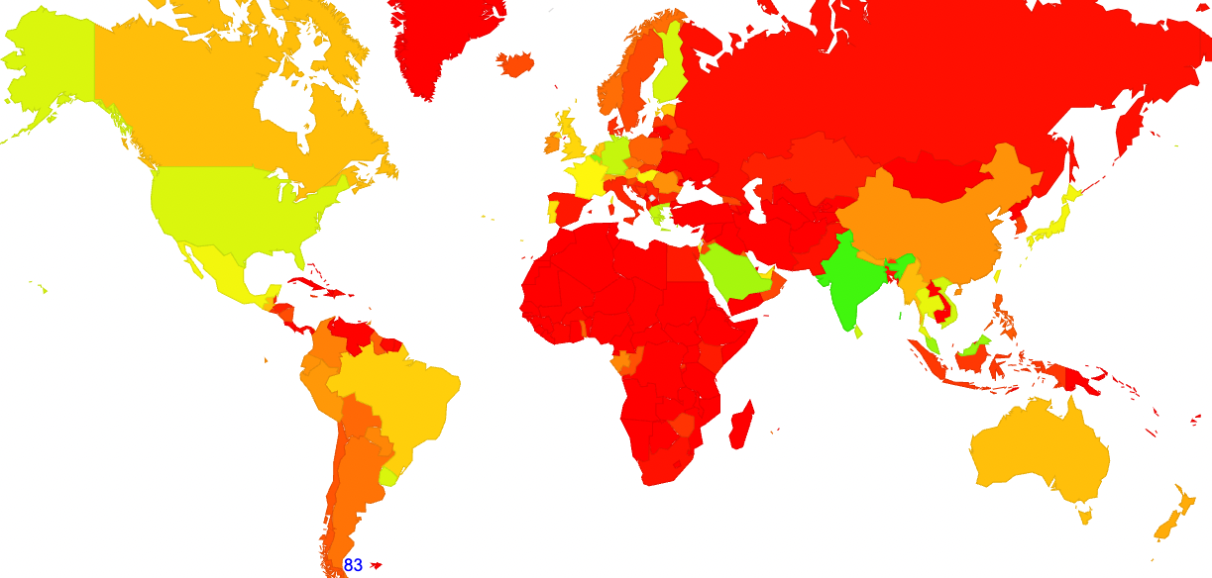
But not everyone all at once
52%
41%
48%
52%
24%
77%
34%
32%
0

Slide 4

Why?
This is a deregulated industry, not a command economy
Access markets are showing signs of saturation – which means that established access enterprises see less scarcity pressures than new market entrants – the larger established providers are showing no signs of stress, so we wait and wait and …
Enterprises are far less enthusiastic about IPv6 than consumer retail (weekday use of IPv6 is lower than weekend use)
Legacy 3G networks had issues with dual protocol support
This is a market where early adopters are penalised with additional cost and laggards are rewarded by avoiding incremental costs

Slide 5

IPv6?
Deployment of IPv6 does not instantly provide the network operator with competitive advantage
  Yes, they still need to support IPv4 access to end client systems
  The support infrastructure is now required for both protocols
But there are some advantages
  The general support for DNS-based Happy Eyeballs in apps and platforms means that dual stack deployment relieves pressures on residual IPv4 pools in CGNs

Slide 6
Not with a Bang but a Whimper
This is shaping to be a story of a protracted decline of reliance on IPv4
There is no clear flag day, and no clear event to say “we’ve arrived!”
Consumer markets are in transition
Enterprise markets will follow
Because we have no alternative path to follow!

